Slide 1

Final Exam Review, Part 1
CDA3101

Slide 2
What’s on the Final
Computer Performance Equation
Digital Logic
Types of circuits
ARM Instructions
ARM to machine code, machine code to ARM
Programming a loop
Creating a stack frame
Numbers and arithmetic
Binary multiplication
Decimal to IEEE 754, IEEE 754 to decimal
Single Cycle Data Path
Control signals for different types of instructions
Pipelined Data Path
Control signals
Stalls
Branch prediction
Cache
Average memory access time
Virtual memory
Virtual memory address translation
Flynn’s taxonomy

Slide 3
Example Problem Step 1
A program consisting of 2,000,000 instructions is executed running at a 1 GHz clock rate. The program uses the following mix of instructions: 40% R-type, 20% ldur, 10% stur, 30% cbz. Cbz and LDUR have a CPI of 5, STUR and R-type have a CPI of 4.
What is the average CPI?
How long does it take to execute the program?
What is the speedup if CBZ is improved to a CPI of 3?

Slide 4
Example Problem Step 2
A program consisting of 2,000,000 instructions is executed running at a 1 GHz clock rate. The program uses the following mix of instructions: 40% R-type, 20% ldur, 10% stur, 30% cbz. Cbz and LDUR have a CPI of 5, STUR and R-type have a CPI of 4.
What is the average CPI?
5*(0.3+0.2) + 4*(0.4+0.1) = 4.5

Slide 5
Example Problem Step 3
A program consisting of 2,000,000 instructions is executed running at a 1 GHz clock rate. The program uses the following mix of instructions: 40% R-type, 20% ldur, 10% stur, 30% cbz. Cbz and LDUR have a CPI of 5, STUR and R-type have a CPI of 4.
What is the average CPI?
5*(0.3+0.2) + 4*(0.4+0.1) = 4.5
How long does it take to execute the program?

Slide 6
Example Problem Step 4
A program consisting of 2,000,000 instructions is executed running at a 1 GHz clock rate. The program uses the following mix of instructions: 40% R-type, 20% ldur, 10% stur, 30% cbz. Cbz and LDUR have a CPI of 5, STUR and R-type have a CPI of 4.
What is the average CPI?
5*(0.3+0.2) + 4*(0.4+0.1) = 4.5
How long does it take to execute the program?
4.5 cycles / instruction * 2e6 instructions /program / (1e9 cycles/second) = 0.009 seconds
What is the speedup if CBZ is improved to a CPI of 3?

Slide 7
Example Problem Step 5
A program consisting of 2,000,000 instructions is executed running at a 1 GHz clock rate. The program uses the following mix of instructions: 40% R-type, 20% ldur, 10% stur, 30% cbz. Cbz and LDUR have a CPI of 5, STUR and R-type have a CPI of 4.
What is the average CPI?
5*(0.3+0.2) + 4*(0.4+0.1) = 4.5
How long does it take to execute the program?
4.5 cycles / instruction * 2e6 instructions /program / (1e9 cycles/second) = 0.009 seconds
What is the speedup if CBZ is improved to a CPI of 3?
Speedup = old time / new time = (CPI*IC*cycle time)_{old} / (CPI*IC*cycle time)_{new}
The only thing that changes is the CPI, so speedup will be a ratio of CPI _{old} / CPI _{new}
New CPI = 0.3*3 + 0.2*5 + (0.4+0.1)*4 = 0.9+1+2 = 3.9
Speedup = 4.5/3.9 = 1.15

Slide 8
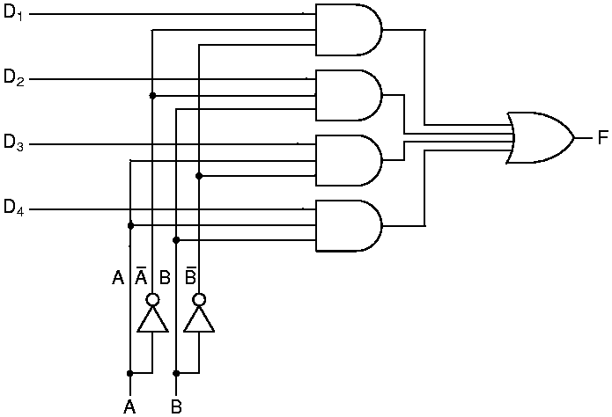
Multiplexor
Multiplexor circuit
Selects one data channel (from many input channels)
Maps the selected channel to the output channel
Sum-of-Products circuit
D₁ … D₄: Data channels
A, B: Control lines
F: Output channel
n control lines allows 2^{n} inputs
Example: To select D₁: A,B=0

Slide 9
Example Problem 2 Step 1
If you need a multiplexor to choose one of 16 inputs, how many control lines do you need?

Slide 10
Example Problem 2 Step 2
If you need a multiplexor to choose which of 16 inputs, how many control lines do you need?
The ceiling of log(16) = 4, so you would need 4 control lines

Slide 11
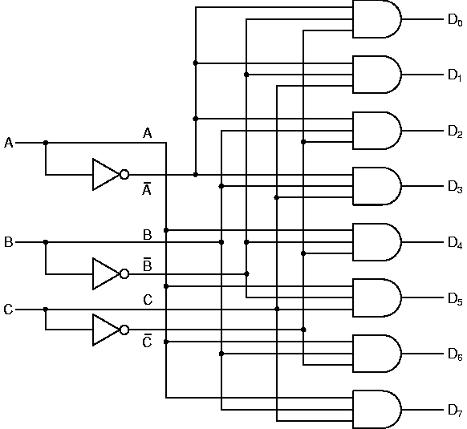
Decoder
Decoder circuit
Given n control lines
Select one of 2^{n} outputs to activate

Slide 12
Example Problem 3 Step 1
If your decoder selects from among 60 outputs how many control lines does it need?

Slide 13
Example Problem 3 Step 2
If your decoder selects from among 60 outputs how many control lines does it need?
The ceiling of log(60) = 6, so 6 control lines are needed
If you want to select the output channel 35, what should your control signals be?

Slide 14
Example Problem 3 Step 3
If your decoder selects from among 40 outputs how many control lines does it need?
The ceiling of log(40) = 6, so 6 control lines are needed
If you want to select the output channel 35, what should your control signals be?
100011

Slide 15
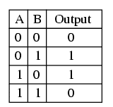
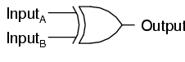
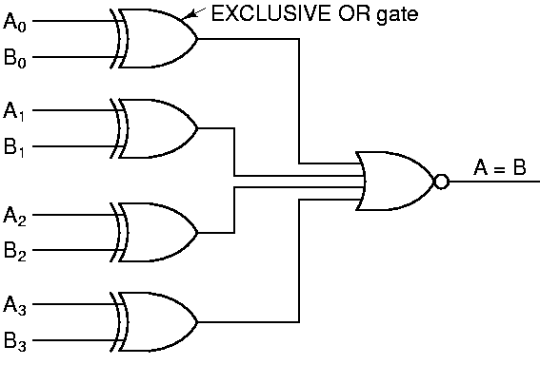
Comparator
Comparator circuit
Given two n-bit vectors A and B
Output 1 if A = B, or 0 otherwise
Simple XOR-gate circuit
A₀, A₁, …, A_{N-1} : Input vector #1
B₀, B₁, …, B_{N-1} : Input vector #2
Note: NOR gate combines N XOR gate outputs
If all inputs to this NOR gate are zero, output is 1
Laws of Boolean Logic
Example: Comparator for Bit i outputs 0 if A_{i} = B_{i}

Slide 16
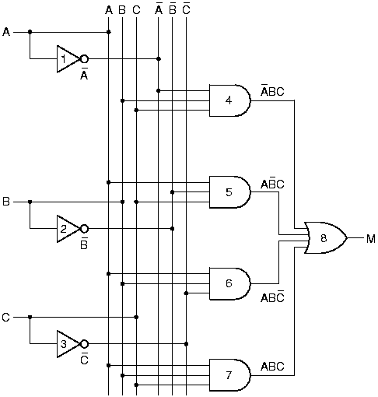
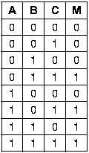
Majority vote circuit
Majority Function
Returns 1 if a majority of inputs are high (=1)
Formula: M(A,B,C) = A’BC + AB’C + ABC’ + ABC
Truth Table ⇒ SOP Circuit:
[Note: A = NOT(A)]
Application: In the Space Shuttle, 3 redundant circuits each compute the same function f. If a MAJORITY of circuit outputs agree (=1), then the 1-valued result is assumed to be correct.

Slide 17
Example Problem 4 Step 1
Translate the following ARM instruction to hexadecimal machine code.
LDURH, X11, [X10, #4]

Slide 18
Example Problem 4 Step 2
Translate the following ARM instruction to hexadecimal machine code.
LDURH, X11, [X10, #4]
Opcode = 01111000010
Offset = 000000100
Rn = 01010
Rt = 01011
01111000010 000000100 00 01010 01011
0111 1000 0100 0000 0100 0001 0100 1011
0x7840414B

Slide 19
Example Problem 5 Step 1
What is the mnemonic for the following ARM machine code instruction, i.e. what type of instruction is it?
0xD3406149

Slide 20
Example Problem 5 Step 2
What is the mnemonic for the following ARM machine code instruction, i.e. what type of instruction is it?
0xD3406149
1101 0011 0100
Longest opcode is 11, shortest is 6, look on sheet for opcodes starting with 110100
LSR is 11010011010
….welcome to reverse engineering! ☺

Slide 21
Example Problem 6 Step 1
Write ARM code for the following high level code. Assume i is in X9, j is in X10, put x in X11
If (i==j)
x=2*i
else
x=2*j

Slide 22
Example Problem 6 Step 2
Write ARM code for the following high level language. Assume i is in X9, j is in X10, put x in X11
If (i==j)
x=2*i
else
x=2*j
SUBS X12, X9, X10
B.NE Else
LSL X11, X9, 1
B DoneIf
Else: LSL X11, X10, 1
DoneIf:

Slide 23
Example Problem 6 Step 3
Write ARM code for the following high level language. Assume i is in X9, j is in X10, put x in X11
If (i==j)
x=2*i
else
x=2*j
SUB X12, X9, X10
CBNZ X12, Else
LSL X11, X9, 1
B DoneIf
Else: LSL X11, X10, 1
DoneIf:

Slide 24
int myProc1(int i, int j)
{ int k = myProc2(i);
k=k+j;
return k; }
Write ARM code that corresponds to this C++ code

Slide 25
int myProc1(int i, int j)
{ int k = myProc2(i);
k=k+j;
return k; }
Write ARM code that corresponds to this C++ code
//first create a stack frame that holds…..

Slide 26
int myProc1(int i, int j)
{ int k = myProc2(i);
k=k+j;
return k; }
Write ARM code that corresponds to this C++ code
//first create a stack frame that holds….. i, j, x29, x30, this means we need how many bytes?

Slide 27
int myProc1(int i, int j)
{ int k = myProc2(i);
k=k+j;
return k; }
Write ARM code that corresponds to this C++ code
//first create a stack frame that holds….. i, j, x29, x30, this means we need how many 32 bytes
sub sp, sp, 32
stur x0, [sp, #0]
stur x1, [sp, #8]
Stur x29, [sp, #16]
stur x30, [sp, #24]

Slide 28
int myProc1(int i, int j)
{ int k = myProc2(i);
k=k+j;
return k; }
Write ARM code that corresponds to this C++ code
//first create a stack frame that holds….. i, j, x29, x30, this means we need how many 32 bytes
sub sp, sp, 32
stur x0, [sp, #0]
stur x1, [sp, #8]
Stur x29, [sp, #16]
stur x30, [sp, #24]
//call myProc2
bl myProc2

Slide 29
int myProc1(int i, int j)
{ int k = myProc2(i);
k=k+j;
return k; }
Write ARM code that corresponds to this C++ code
//first create a stack frame that holds….. i, j, x29, x30, this means we need how many 32 bytes
sub sp, sp, 32
stur x0, [sp, #0]
stur x1, [sp, #8]
stur x29, [sp, #16]
stur x30, [sp, #24]
//call myProc2
bl myProc2
//save k
mov x2, x1

Slide 30
int myProc1(int i, int j)
{ int k = myProc2(i);
k=k+j;
return k; }
Write ARM code that corresponds to this C++ code
//first create a stack frame that holds….. i, j, x29, x30, this means we need how many 32 bytes
sub sp, sp, 32
stur x0, [sp, #0]
stur x1, [sp, #8]
stur x29, [sp, #16]
stur x30, [sp, #24]
//call myProc2
bl myProc2
//save k
mov x2, x1
//restore items from stack
ldur x0, [sp, #0]
ldur x1, [sp, #8]
ldur x29, [sp, #16]
ldur x30, [sp, #24]

Slide 31
int myProc1(int i, int j)
{ int k = myProc2(i);
k=k+j;
return k; }
Write ARM code that corresponds to this C++ code
//first create a stack frame that holds….. i, j, x29, x30, this means we need how many 32 bytes
sub sp, sp, 32
stur x0, [sp, #0]
stur x1, [sp, #8]
stur x29, [sp, #16]
stur x30, [sp, #24]
//call myProc2
bl myProc2
//save k
mov x2, x1
//restore items from stack
ldur x0, [sp, #0]
ldur x1, [sp, #8]
ldur x29, [sp, #16]
ldur x30, [sp, #24]
//update k
add x2, x2, x1

Slide 32
int myProc1(int i, int j)
{ int k = myProc2(i);
k=k+j;
return k; }
Write ARM code that corresponds to this C++ code
//first create a stack frame that holds….. i, j, x29, x30, this means we need how many 32 bytes
sub sp, sp, #32
stur x0, [sp, #0]
stur x1, [sp, #8]
stur x29, [sp, #16]
stur x30, [sp, #24]
//call myProc2
bl myProc2
//save k
mov x2, x1
//restore items from stack
ldur x0, [sp, #0]
ldur x1, [sp, #8]
ldur x29, [sp, #16]
ldur x30, [sp, #24]
add sp, sp, #32
//update k
add x2, x2, x1
//return
br x30

Slide 33
Flags and Conditions
Flag | Condition
N | Negative number – 1 in most significant bit of result
Z | Result is zero
V | Overflow – the result of a signed operation results in overflow
C | Carry out of most significant bit – unsigned overflow
SUBS X21, X17, X19
If X21 is zero, Z set to 1
If X21 is negative N is set to 1
If X21 overflows (number is bigger than what is possible in a 64 bit signed integer) V is set to 1
C doesn’t come into play because this is a signed operation
Flag | Condition Code Test
EQ | Z=1
NE | Z=0
LT | N!=V
GT | N=V

Slide 34
Memory Address | Data
0x8000000000000000 | 0xA1
0x8000000000000001 | 0x32
0x8000000000000002 | 0x5B
0x8000000000000003 | 0xC6
0x8000000000000004 | 0x92
0x8000000000000005 | 0x58
0x8000000000000006 | 0x32
0x8000000000000007 | 0x11
0x8000000000000008 | 0x13
Register | Data
X1 | 0x0000000000000000
X2 | 0x0000000000000000
X3 | 0x0000000000000000
X4 | 0x0000000000000000
X5 | 0x0000000000000000
X6 | 0x0000000000000000
X7 | 0x0000000000000000
X8 | 0x0000000000000000
X9 | 0x8000000000000000
X10 | 0x0000000000000000
X11 | 0xA1325BC692583211
….. | ….
What are the contents of X11 after the following instruction is executed if big endian storage is used?
LDUR X11, [X9, #0]
Big end

Slide 35
Example Problem 7 Step 2
Memory Address | Data
0x8000000000000000 | 0xA1
0x8000000000000001 | 0x32
0x8000000000000002 | 0x5B
0x8000000000000003 | 0xC6
0x8000000000000004 | 0x92
0x8000000000000005 | 0x58
0x8000000000000006 | 0x32
0x8000000000000007 | 0x11
0x8000000000000008 | 0x13
Register | Data
X1 | 0x0000000000000000
X2 | 0x0000000000000000
X3 | 0x0000000000000000
X4 | 0x0000000000000000
X5 | 0x0000000000000000
X6 | 0x0000000000000000
X7 | 0x0000000000000000
X8 | 0x0000000000000000
X9 | 0x8000000000000000
X10 | 0x0000000000000000
X11 | 0x11325892C65B32A1
….. | ….
What are the contents of X11 after the following instruction is executed if little endian storage is used?
LDUR X11, [X9, #0]
Little end

Slide 36
Example Problem 8 Step 1
What floating point number is represented by the following IEEE 754 floating point format code?
0x31E80000

Slide 37
Example Problem 8 Step 2
What floating point decimal number is represented by the following IEEE 754 floating point format code?
0x31E80000
0011 0001 1110 1000 0000 0000 0000 0000
0 01100011 1101000 0000 0000 0000 0000
Sign = 0
Biased exponent = 64+32+2+1 = 99, exponent = 99-127 = -28
Fraction = ½ + ¼ + 1/16 = 0.8125
So our number is
1.8125 x 2⁻²⁸
Get it completely in to decimal (with a decimal exponent….)
6.752x10⁻⁹

Slide 38
Example Problem 8 Step 2
What floating point decimal number is represented by the following IEEE 754 floating point format code?
0x00680000

Slide 39
Example Problem 8 Step 2
What floating point decimal number is represented by the following IEEE 754 floating point format code?
0x00680000
0000 0000 0110 1000 0000 0000 0000 0000
0 00000000 1101000 0000 0000 0000 0000
Sign = 0
Biased exponent = 0, exponent =0-127, denormalized number
Fraction = ½ + ¼ + 1/16 = 0.8125
So our number is
0.8125 x 2⁻¹²⁷
Get it completely in to decimal (with a decimal exponent….)
4.775x10⁻³⁹

Slide 40
Example Problem 9 Step 1
Convert the following floating point number to IEEE 754 format expressed in hexadecimal:
1.75

Slide 41
Example Problem 9 Step 2
Convert the following floating point number to IEEE 754 format expressed in hexadecimal:
1.75
0.75 = 0.5+0.25
Binary representation of 1.75 = 1.11
Fraction = 0.11
Sign = 0
Exponent = 0, biased exponent = 0+127 = 127
0 01111111 11000000000000000000000
0011 1111 1110 0000 0000 0000 0000 0000
0x3FE00000

Slide 42
Example Problem 9 Step 1
Express negative infinity in IEEE 754 format hexadecimal

Slide 43
Example Problem 9 Step 1
Express negative infinity in IEEE 754 format hexadecimal
Sign = 1
Exponent = 11111111
Fraction = 0
1 11111111 00000000000000000000000
1111 1111 1000 0000 0000 0000 0000 0000
0xFF800000

Slide 44
Multiply 10 times 6
Iteration | Step | Multiplicand | Product|Multiplier | Action
0 | Initial values | 1010 | 00000110
1 | 1
 | 2
2 | 1
 | 2
3 | 1
 | 2
4 | 1
 | 2

Slide 45
Example Problem 10 Step 2
Multiply 10 times 6
Iteration | Step | Multiplicand | Product|Multiplier | Action
0 | Initial values | 1010 | 00000110
1 | 1 | 1010 | 00000110 | Lowest bit of Product|Multiplier is 0, do not add multiplicand
 | 2 |  | 00000011 | Shift right
2 | 1 |  |  | Lowest bit of Product|Multiplier is 1, add multiplicand
 | 2 |  |  | Shift right
3 | 1
 | 2
4 | 1
 | 2

Slide 46
Example Problem 10 Step 3
Multiply 10 times 6
Iteration | Step | Multiplicand | Product|Multiplier | Action
0 | Initial values | 1010 | 00000110
1 | 1 | 1010 | 00000110 | Lowest bit of Product|Multiplier is 0, do not add multiplicand
 | 2 |  | 00000011 | Shift right
2 | 1 |  | 10100011 | Lowest bit of Product|Multiplier is 1, add multiplicand
 | 2 |  | 01010001 | Shift right
3 | 1 |  |  | Lowest bit of Product|Multiplier is ?
 | 2
4 | 1
 | 2

Slide 47

Example Problem 10 Step 4
Multiply 10 times 6
Iteration | Step | Multiplicand | Product|Multiplier | Action
0 | Initial values | 1010 | 00000110
1 | 1 | 1010 | 00000110 | Lowest bit of Product|Multiplier is 0, do not add multiplicand
 | 2 |  | 00000011 | Shift right
2 | 1 |  | 10100011 | Lowest bit of Product|Multiplier is 1, add multiplicand
 | 2 |  | 01010001 | Shift right
3 | 1 |  | 11110001 | Lowest bit of Product|Multiplier is 1, add multiplicand
 | 2 |  | 01111000 | Shift right
4 | 1
 | 2

Slide 48
Example Problem 10 Step 5
Multiply 10 times 6
Iteration | Step | Multiplicand | Product|Multiplier | Action
0 | Initial values | 1010 | 00000110
1 | 1 | 1010 | 00000110 | Lowest bit of Product|Multiplier is 0, do not add multiplicand
 | 2 |  | 00000011 | Shift right
2 | 1 |  | 10100011 | Lowest bit of Product|Multiplier is 1, add multiplicand
 | 2 |  | 01010001 | Shift right
3 | 1 |  | 11110001 | Lowest bit of Product|Multiplier is 1, add multiplicand
 | 2 |  | 01111000 | Shift right
4 | 1 |  |  | Lowest bit of Product|Multiplier is ?
 | 2

Slide 49

Example Problem 10 Step 6
Multiply 10 times 6
Iteration | Step | Multiplicand | Product|Multiplier | Action
0 | Initial values | 1010 | 00000110
1 | 1 | 1010 | 00000110 | Lowest bit of Product|Multiplier is 0, do not add multiplicand
 | 2 |  | 00000011 | Shift right
2 | 1 |  | 10100011 | Lowest bit of Product|Multiplier is 1, add multiplicand
 | 2 |  | 01010001 | Shift right
3 | 1 |  | 11110001 | Lowest bit of Product|Multiplier is 1, add multiplicand
 | 2 |  | 01111000 | Shift right
4 | 1 |  | 01111000 | Lowest bit of Product|Multiplier is 0, do not add multiplicand
 | 2 |  | 00111100 | Shift right

Slide 50
What are the values of reg2loc, alusrc, regwrite, and memtoreg for an R-type instruction?

Slide 51
Example Problem 11 Step 2
What are the values of reg2loc, alusrc, regwrite, and memtoreg for an R-type instruction?

Slide 52
Which control signals are forwarded for use in the write-back stage?

Slide 53
Example Problem 12 Step 2
Which control signals are forwarded for use in the write-back stage?
RegWrite, MemtoReg
Which control signals are forwarded for use in the mem stage?

Slide 54
Example Problem 12 Step 3
Which control signals are forwarded for use in the write-back stage?
RegWrite, MemtoReg
Which control signals are forwarded for use in the mem stage?
MemRead, MemWrite, Branch
Which control signals are forwarded for use in the execute stage?
ALUSrc, ALUOp

Slide 55
A single cycle processor can be split into a 5 stage pipeline with latencies of 200 ps, 150 ps, 100 ps, 200 ps, 150 ps.
What is the cycle time for a single cycle processor?
What is the cycle time for a pipelined processor?
How long does it take for an instruction to execute on the pipelined processor?

Slide 56
A single cycle processor can be split into a 5 stage pipeline with latencies of 200 ps, 150 ps, 100 ps, 200 ps, 150 ps.
What is the cycle time for a single cycle processor?
200+150+100+200+150 = 800 ps
What is the cycle time for a pipelined processor?
200 ps
How long does it take for an instruction to execute on the pipelined processor?
1000 ps

Slide 57
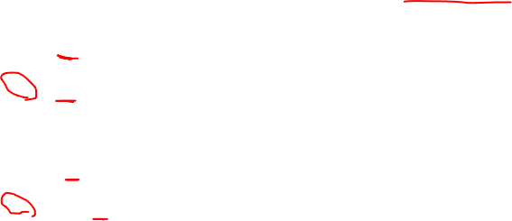
Consider the following sequence of instructions executed on the 5-stage pipeline. The pipeline uses forwarding for data hazards and conditional branch is evaluated in the instruction decode stage. Which instructions are stalled because of a data hazard?
40 add X1, X2, X3 44 cbz X1, branch 48 add X5, X1, X1 52 ldur X1, [X6, #3] 56 add X2, X1, X5 60 branch: ldur X7, [X6, #4]
64 add X3, X2, X6

Slide 58

Consider the following sequence of instructions executed on the 5-stage pipeline. The pipeline uses forwarding for data hazards and conditional branch is evaluated in the instruction decode stage. Which instructions are stalled because of a data hazard?
40 add X1, X2, X3 44 cbz X1, branch //since cbz is evaluated in ID stage, it needs to wait for x1 to be calculated 48 add X5, X1, X1 52 ldur X1, [X6, #3] 56 add X2, X1, X5 //ldur loads x1 in MEM stage, so add needs to wait for x1 60 branch: ldur X7, [X6, #4]
64 add X3, X2, X6

Slide 59

Branch Prediction
Static branch prediction
Predict branch at compile time
Examples
Predict “not taken” for for branching out of a loop
Predict “taken” for a backward branch to stay in a loop
Dynamic branch prediction
Predict during running
1 bit predictor (do whatever was done last time)
2 bit predictor (change prediction after getting it wrong twice)
Keep a table of past predictions

Slide 60

Branch Prediction
LoopStart: cbz x9, LoopDone
ldur x10, [x13, x16]
ldur x11, [x14, x16]
add x12, x10, x11
stur x12, [x15, x16]
sub x9, x9, 1
add x16, x16, 8
b LoopStart
LoopDone: br x30

Slide 61
Branch Prediction
LoopStart: cbz x9, LoopDone
ldur x10, [x13, x16]
ldur x11, [x14, x16]
add x12, x10, x11
stur x12, [x15, x16]
sub x9, x9, 1
add x16, x16, 8
b LoopStart
LoopDone: br x30
Best static branch predictor: predict not taken

Slide 62
Branch Prediction
LoopStart: ldur x10, [x13, x16]
ldur x11, [x14, x16]
add x12, x10, x11
stur x12, [x15, x16]
sub x9, x9, 1
add x16, x16, 8
cbnz x9, LoopStart
br x30

Slide 63
Branch Prediction
LoopStart: ldur x10, [x13, x16]
ldur x11, [x14, x16]
add x12, x10, x11
stur x12, [x15, x16]
sub x9, x9, 1
add x16, x16, 8
cbnz x9, LoopStart
br x30
Best branch prediction: branch taken

Slide 64
A processor has an L1 cache with a 10ns access time and a hit rate of 90%, and L2 cache with a 20ns access time and hit rate of 80%, and main memory access time of 50ns.
What is the AMAT for a look aside cache?

Slide 65
A processor has an L1 cache with a 10ns access time and a hit rate of 90%, and L2 cache with a 20ns access time and hit rate of 80%, and main memory access time of 50ns.
What is the AMAT for a look aside cache?
0.9*10 + 0.1(0.8*20 + 0.2*50) = 9+0.1(16+10)=11.6

Slide 66
A processor has an L1 cache with a 10ns access time and a hit rate of 90%, and L2 cache with a 20ns access time and hit rate of 80%, and main memory access time of 50ns.
What is the AMAT for a look aside cache?
0.9*10 + 0.1(0.8*20 + 0.2*50) = 9+0.1(16+10)=11.6
What is the AMAT for a look through cache?

Slide 67
A processor has an L1 cache with a 10ns access time and a hit rate of 90%, and L2 cache with a 20ns access time and hit rate of 80%, and main memory access time of 50ns.
What is the AMAT for a look aside cache?
0.9*10 + 0.1(0.8*20 + 0.2*50) = 9+0.1(16+10)=11.6ns
What is the AMAT for a look through cache?
10+0.1(20+0.2*50) = 10 + 0.1(20+10) = 13ns

Slide 68
Example Problem 15 Step 1
Main memory contains a total of 2³ frames and each frame is 2³ bytes. The page table is as follows.
Page | Valid | Frame
0 | 0
1 | 1 | 5
2 | 0
3 | 0
4 | 1 | 1
5 | 1 | 2
6 | 0
7 | 0
8 | 1 | 0
9 | 1 | 4
10 | 0
11 | 1 | 6
12 | 0
13 | 1 | 3
14 | 0
15 | 1 | 7
How many bits are required for the offset?
How many bits are required for the physical address?
How many bits are required for the virtual address?

Slide 69
Example Problem 15 Step 2
Main memory contains a total of 2³ frames and each frame is 2³ bytes. The page table is as follows.
Page | Valid | Frame
0 | 0
1 | 1 | 5
2 | 0
3 | 0
4 | 1 | 1
5 | 1 | 2
6 | 0
7 | 0
8 | 1 | 0
9 | 1 | 4
10 | 0
11 | 1 | 6
12 | 0
13 | 1 | 3
14 | 0
15 | 1 | 7
How many bits are required for the offset? A frame is 2³ bytes, so the offset is log(2³) = 3 bits
How many bits are required for the physical address? 2³ frames*2³ bytes/frame = 2⁶ bytes. log(2⁶) = 6 bits
How many bits are required for the virtual address?
The page table has 16 entries. 16 pages*2³ bytes/page = 2⁷ bytes
log(2⁷) = 7 bits
Frames and pages are the same size

Slide 70
Example Problem 15 Step 3
Main memory contains a total of 2³ frames and each frame is 2³ bytes. The page table is as follows.
Page | Valid | Frame
0 | 0
1 | 1 | 5
2 | 0
3 | 0
4 | 1 | 1
5 | 1 | 2
6 | 0
7 | 0
8 | 1 | 0
9 | 1 | 4
10 | 0
11 | 1 | 6
12 | 0
13 | 1 | 3
14 | 0
15 | 1 | 7
How many bits are required for the offset? A frame is 2³ bytes, so the offset is log(2³) = 3 bits
How many bits are required for the physical address? 2³ frames*2³ bytes/frame = 2⁶ bytes. log(2⁶) = 6 bits
How many bits are required for the virtual address?
The page table has 16 entries. 16 pages*2³ bytes/page = 2⁷ bytes
log(2⁷) = 7 bits
Frames and pages are the same size
Translate the virtual address 1000001 to a physical address.

Slide 71
Example Problem 15 Step 4
Main memory contains a total of 2³ frames and each frame is 2³ bytes. The page table is as follows.
Page | Valid | Frame
0 | 0
1 | 1 | 5
2 | 0
3 | 0
4 | 1 | 1
5 | 1 | 2
6 | 0
7 | 0
8 | 1 | 0
9 | 1 | 4
10 | 0
11 | 1 | 6
12 | 0
13 | 1 | 3
14 | 0
15 | 1 | 7
How many bits are required for the offset? A frame is 2³ bytes, so the offset is log(2³) = 3 bits
How many bits are required for the physical address? 2³ frames*2³ bytes/frame = 2⁶ bytes. log(2⁶) = 6 bits
How many bits are required for the virtual address?
The page table has 16 entries. 16 pages*2³ bytes/page = 2⁷ bytes
log(2⁷) = 7 bits
Frames and pages are the same size
Translate the virtual address 1000001 to a physical address.
1000 001 -> offset = 001, page = 1000 = 8
Frame = 0 = 000
Physical address = 000 001 = 000001

Slide 72
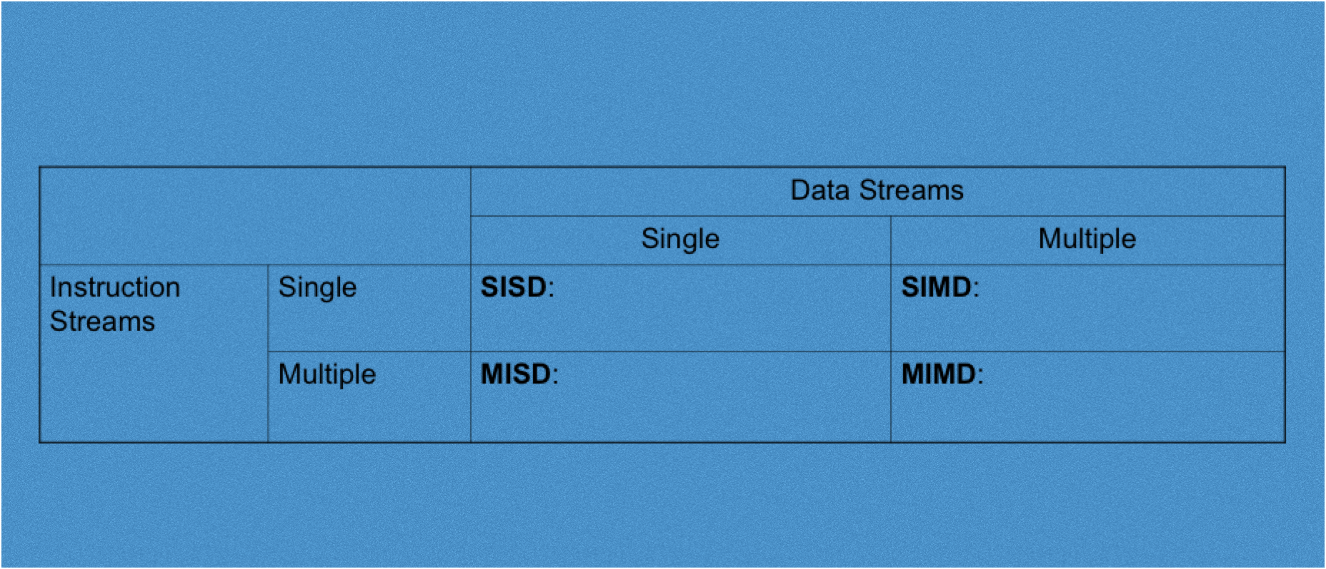
Flynn’s Taxonomy
No “processor” that does this. But fault tolerance and having multiple computers operating on the same data could fall into this category

Slide 73
Flynn’s Taxonomy
Single program, multiple data
Shared memory processing

Slide 74
Flynn’s Taxonomy
Single program, multiple data
multiple processors networked together to accomplish a task

Slide 75
Flynn’s Taxonomy
Shared memory processing
multiple cores
threading
single physical address space for all processors

